Slide 1
MYSQL Practice
TA : Benjamin Hur
March 18th 2015
Bio & Health Informatics Lab., Seoul National University

Slide 2
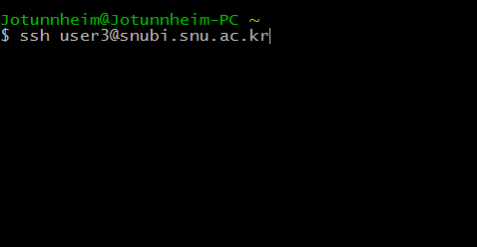

Notice
Server : snubi2.snu.ac.kr
USER Account : user 1 ~ 6
USER Password : bioinfo
MYSQL Account : user 1 ~ 6
MYSQL Password : bioinfo
Make your own folder at your home directory
(When logged in, your initial directory will be your home directory)
cmd : mkdir “your student ID” #make folder named as your student ID
cmd : cd “your student ID”
< Example >
< Example >

Slide 3
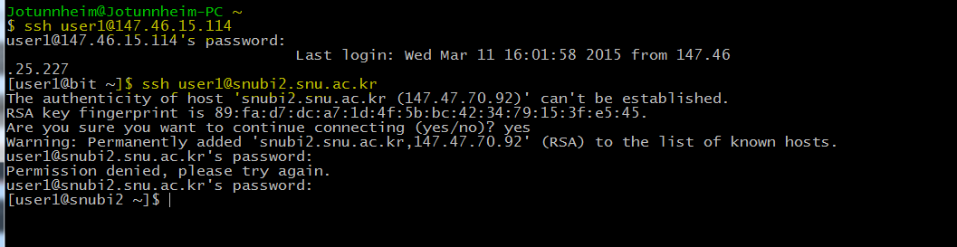
Notice
For those who cannot connect to snubi2.snu.ac.kr server.
Connect to 147.46.15.114 first, then connect to snubi2.snu.ac.kr

Slide 4
Objective
1. Download two different genome bacteria ( Bacillus, E.coli ) from NCBI.
2. Save those information to your own database.
3. Utilize these data for several purpose.
Using MySQL & Python.
MYSQL interpreter
MYSQL python module (MySQLdb)

Slide 5
MYSQL with interpreter

Slide 6
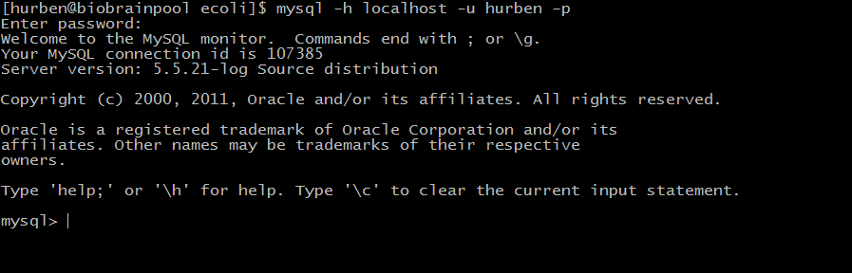
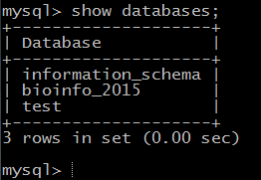
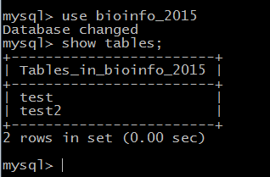
MYSQL interpreter
CMD : Mysql –h localhost –u “User_ID” -p
CMD: show databases;
CMD: use bioinfo_2015;
CMD: show tables;

Slide 7

bioinfo_2015
CMD : use bioinfo_2015;
Database2
CMD : show tables;
NOTE : In some cases, table may not exist.
Database3
CMD : show databases;

Slide 8
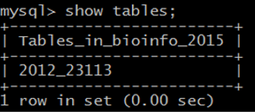
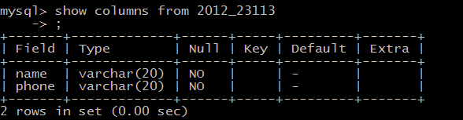
#Create new table
CMD :
create table 2012_23113 (name varchar(20) default '-' not null,
phone varchar(20) default '-' not null);
table name
defining column 1
#show columns of the table
CMD :
show columns from 2012_23113;
Name | Phone
- | -
- | -
=

Slide 9
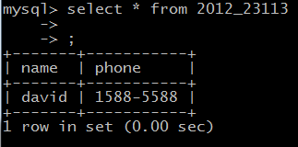
#Insert values to empty table
CMD :
Insert into 2012_23113 values (‘david’, ‘1588-5588’);
#show table contents
CMD :
Select * from 2012_23113;
Name | Phone
david | 1588-5588
- | -
=

Slide 10
MYSQL with python.

Slide 11
MYSQL python
Same steps as MYSQL interpreter
Select database
Create table
Insert values to table
However, python cannot directly use MYSQL without supporting module.
…and several minor issues.

Slide 12
Important notes(1)
import MySQLdb
#Loading MySQLdb library for python. Without this, python cannot use MYSQL.
#Downloaded from http://sourceforge.net/projects/mysql-python/files/mysql-python/1.2.3/
db = MySQLdb.connect(host=“localhost”, user=“user id”, passwd=“your password”,
db=“bioinfo_2015”)
#Defining specific user & DB
cursor = db.cursor()
command = “~~~~~~”
#command = “create table test ( name varchar(20) ……… );”
cursor.execute(command)
#Execute command(query) to predefined db.
#always need to commit database
db.commit()

Slide 13
Important notes(2)
Compared to MYSQL interpreter, visualization is not easy.
We need programmatic way to show table contents.
Lets say we have table named “2012_23113”
command = “show columns from 2012_23113;”
cursor.execute(command)
#However, will not visualize on our terminal window.
show_results = cursor.fetchall()
#Thus, we need to fetch the output from the cursor.
#Note that c.fetchall() will save output as list.
print show_results
print show_results[i]
In computer science and technology, a database cursor is a control structure that enables traversal over the records in a database. Cursors facilitate subsequent processing in conjunction with the traversal, such as retrieval, addition and removal of database records. The database cursor characteristic of traversal makes cursors akin to the programming language concept of iterator

Slide 14
#About Cursor :
http://en.wikipedia.org/wiki/Cursor_(databases)
http://ko.wikipedia.org/wiki/데이터베이스_커서
#Create table
command = create table 2012_23113 (name varchar(20) default '-' not null, phone varchar(20) default '-' not null);
c.execute(command)
#Inserting values to table
command = “insert into table_name values(‘A’, ’B’);”
c.execute(command)

Slide 15
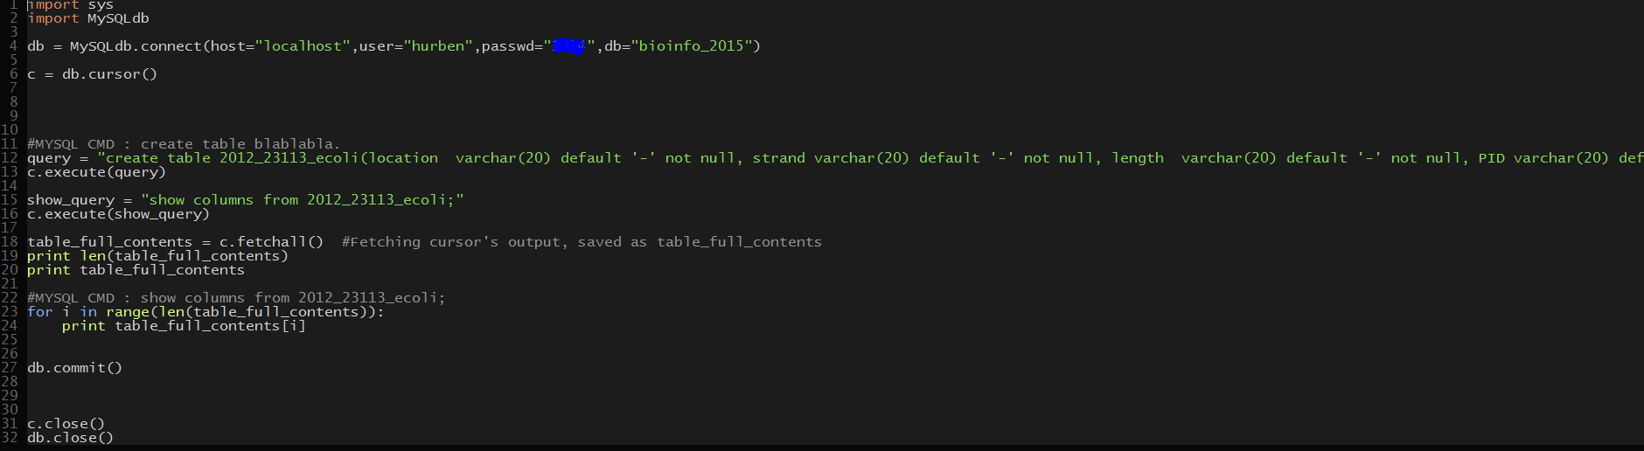
Examples (create table)

Slide 16
Practice

Slide 17
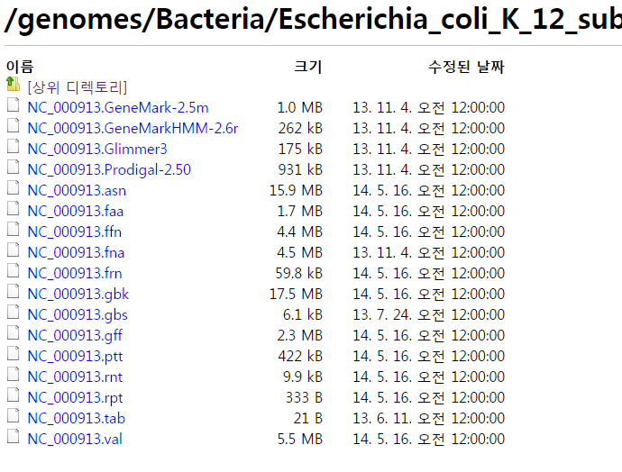
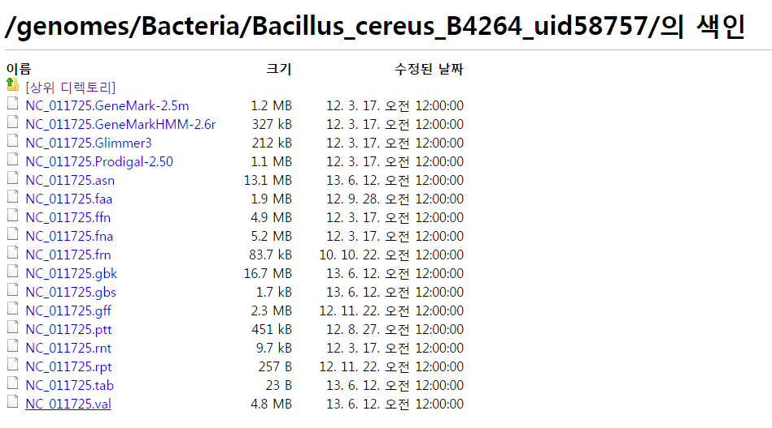
Data
Bacillus_cereus_B4264_uid58757
Escherichia_coli_K_12_substr__MG1655_uid57779
ftp://ftp.ncbi.nlm.nih.gov/genomes/Bacteria/Bacillus_cereus_B4264_uid58757/
ftp://ftp.ncbi.nlm.nih.gov/genomes/Bacteria/Escherichia_coli_K_12_substr__MG1655_uid57779

Slide 18
Data Info.
Summary data (.rpt)
Genbank (.gbk), ASN1 (.asn), binary ASN1 (.val) and fasta (.fna) format sequences
Fasta format gene (.fnn) and protein (.faa) sequences
Gene and protein information (location, strand, product etc.) (.gff and .ptt).
GeneMark, GeneMarkHMM, Glimmer and Prodigal gene predictions
A list of updates since the last release (.rps).

Slide 19
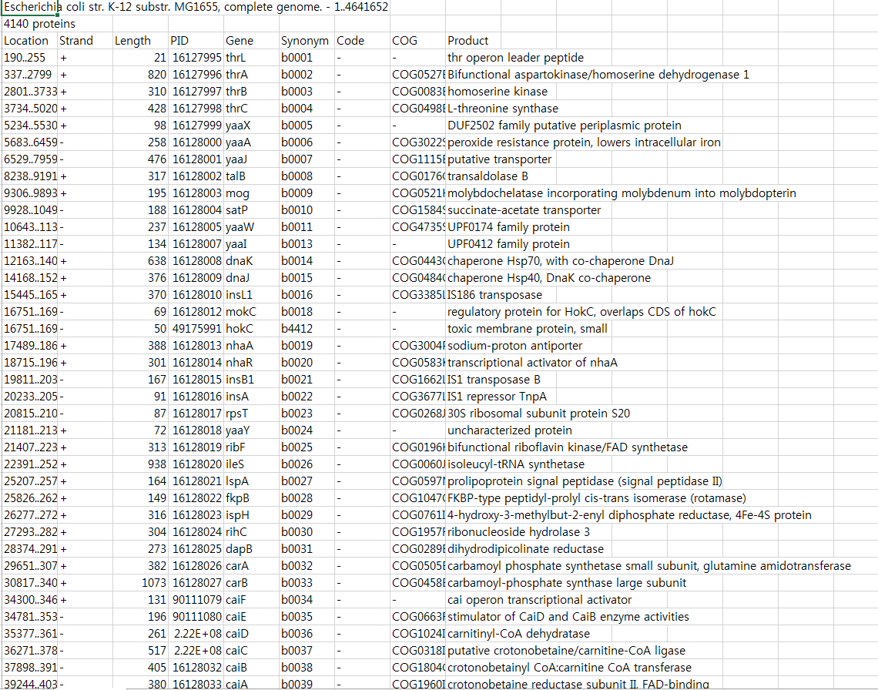
PTT ( Protein table )
Location | Strand | … | … | … | Synonym | Code | Cog | Product
1..250 | + | … | … | … | B0001 | - | - | Blabla
337..2799 | - | … | … | … | B0002 | - | COG0527 | blabla
9 columns, N rows
Download these ptt files for each bacteria.
Example ) wget download link

Slide 20
Practice
1. From downloaded two bacteria ptt files, create tables for each bacteria
Name those tables as Student_ID_Bacteria_Name
ex1. 2012_23113_bacillus
ex2. 2012_23113_ecoli
Tip : Each ptt file have 9 columns
command = “create table 2012_23113 (location varchar(20) default '-' not null,
strand varchar(20) default '-' not null, ……… , product varchar(20) default ‘-’ not null);”

Slide 21
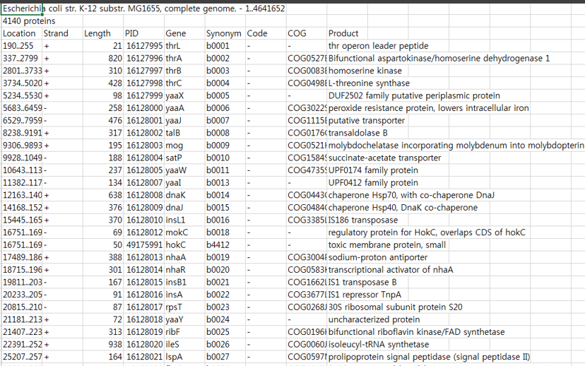
Practice
2. Insert values to those tables
Tip : We cannot manually insert every 4140 lines to tables.
So we need to open & read a text file using a program.
Example using for loop
input_file = ‘File name'
open_file = file(input_file,'r')
file_readlines = open_file.readlines()
For i in range(3,len(file_readlines)):
read = file_readlines[i]

Slide 22
Practice
input_file = ‘File name'
open_file = file(input_file,'r')
file_readlines = open_file.readlines()
For i in range(3, len(file_readlines)):
read = file_readlines[i]
read = read.replace(‘\n,’’)
read = read.replace(“’”,’’)
token = read.split(‘\t’)
token[0]
token[5]
token[8]
command = "insert into 2012_23113_ecoli values (‘ “ + str(token[0]) + “ ’, ‘ " + str(token[1]) + ….. + str(token[8]) + “ ‘ ); ”
c.execute(query)
db.commit()
#Be careful when using string, variables.

Slide 23
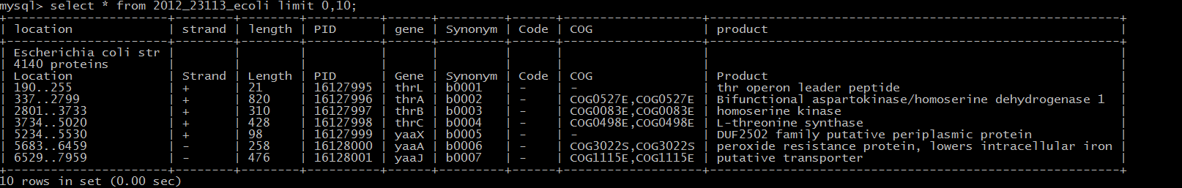
Practice
There is a better way to insert data to table from a text file
USE “LOAD” from MYSQL
cmd: load data local infile path/text.txt into table table_name

Slide 24
Unnecessary information
delete from table_name where column_name=‘string’;
OR… USE “IGNORE” while “load”
cmd: load data local infile path/text.txt into table table_name ignore 3 lines

Slide 25
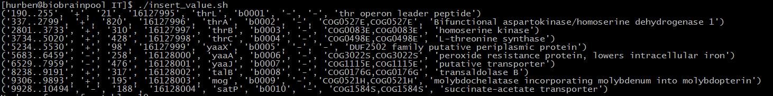
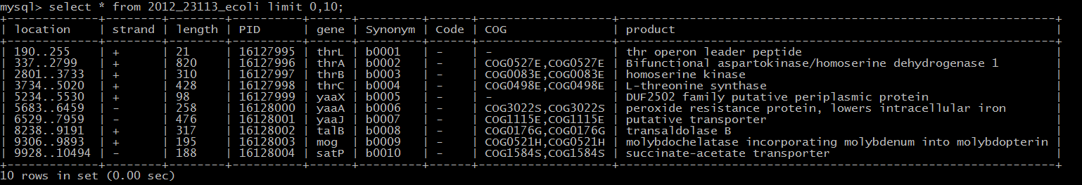
< printed by python >
< printed by MYSQL interpreter >

Slide 26
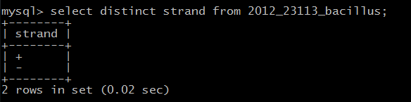
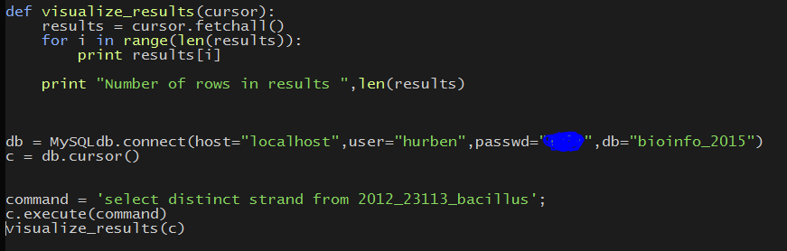
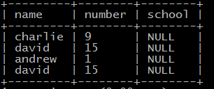

Data manipulation
Select
#select distinct values
Select distinct column_name from table_name
#select specific values that satisfy your condition
Select column_name from table_name where column_name=‘value’;
<Before>
<After>

Slide 27
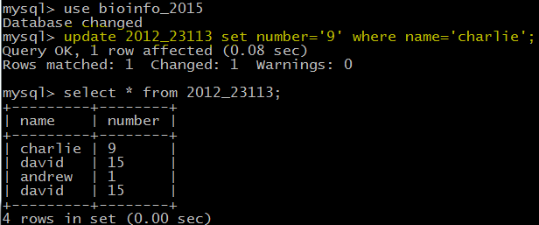
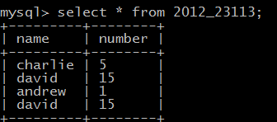
Data manipulation
Update
#change values
update table_name set column_name=‘value to modify’ where column_name=‘value name’
<Before>
<After>

Slide 28
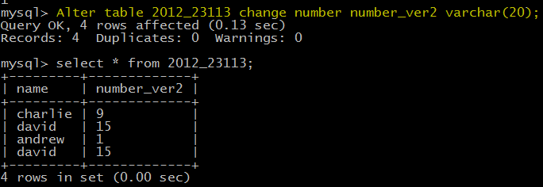
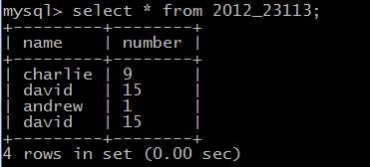
Data manipulation
Alter
#change column name
alter table table_name change current_name new_name datatype;
<Before>
<After>

Slide 29
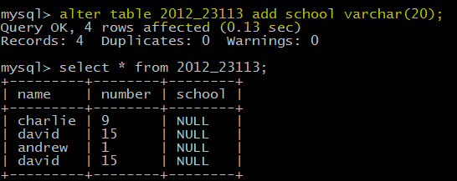
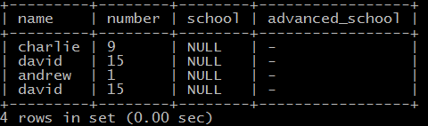
Data manipulation
Alter
#Add new column to table
alter table table_name add new_column_name datatype;
#Add new column to table, more specified
alter table table_name add new_column_name datatype default ‘-’;

Slide 30
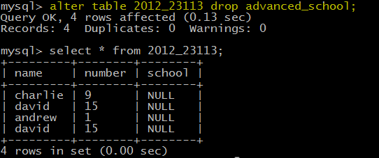
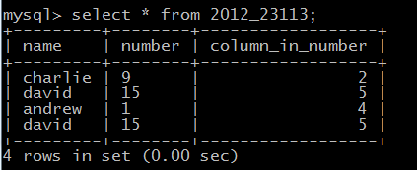
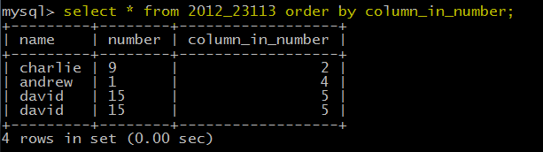
Data manipulation
Alter
#remove column from table
alter table table_name drop column_name;
#sort by “column” (ascend/descend)
select * from table_name order by column_name;
select * from table_name order by column_name desc;
#TIP : if you are planning to sort numerical values,
you need to define values as int not string.

Slide 31
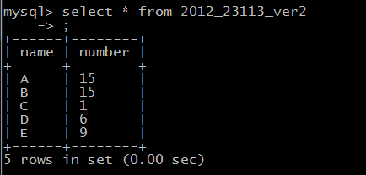
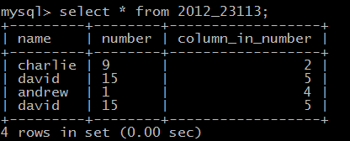
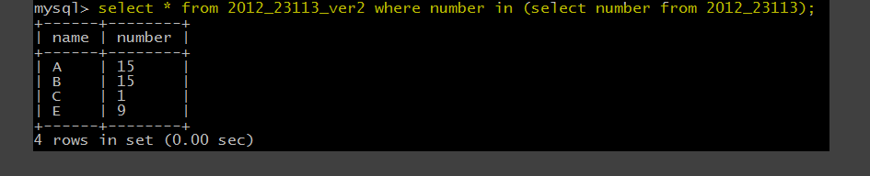
Data manipulation
Advanced use
#Find common values from two different tables
Table 2012_23113_ver2
Table 2012_23113

Slide 32
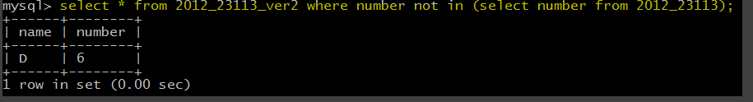
Data manipulation
Advanced use
#From certain column, find values that are not common from two different tables (1)
Table 2012_23113_ver2
Table 2012_23113

Slide 33
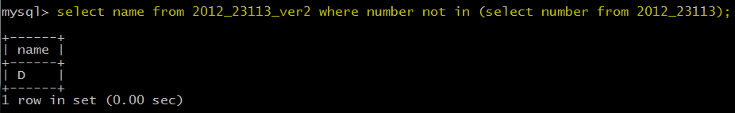
Data manipulation
Advanced use
#From certain column, find values that are not common from two different tables (2)
Table 2012_23113_ver2
Table 2012_23113

Slide 34
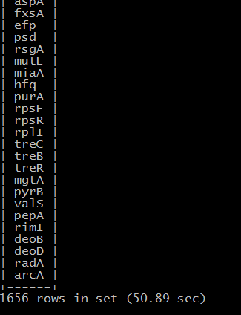
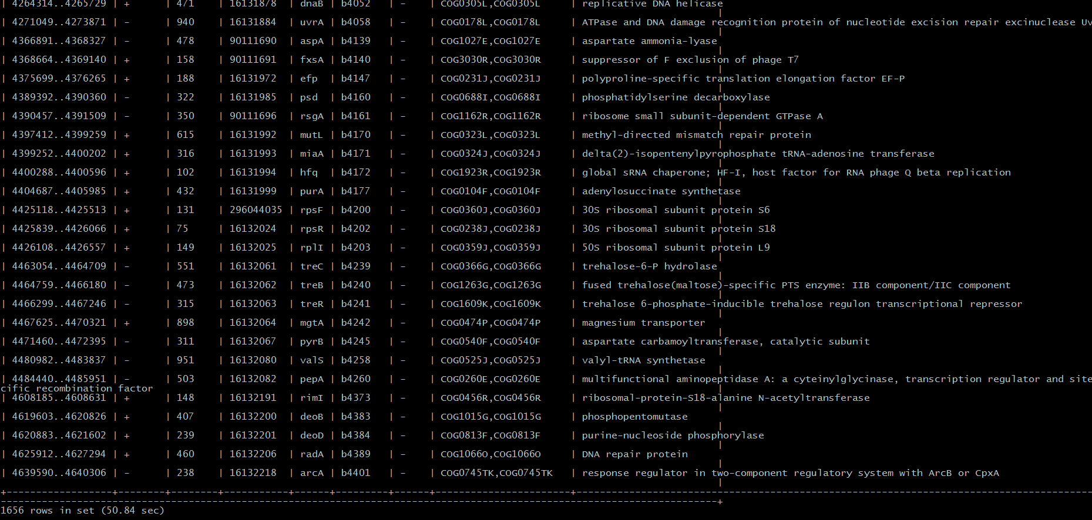
Data manipulation
Advanced use
Real example : Find common genes that are in E.coli and Bacillus

Slide 35
HOMEWORK

Slide 36
HW
1. Make each table ( StudentID_bacillus , StudentID_ecoli ) that contains info. of each ptt file.
2. For each table, add a new column that contains appropriate sequences.
3. Count every 2-mer of each protein sequence and save those count with new columns
As a result, the table would look like this
Location | Strand | … | … | gene | Synonym | Code | Cog | Product | sequence | ME | EN
1..250 | + | … | … | ABC | B0001 | - | - | Blabla | MENISDL… | 4 | 6
337..2799 | - | … | … | EFG | B0002 | - | COG0527 | blabla | RFTIQKDYLVR | 24 | 0
….
+400 more columns

Slide 37
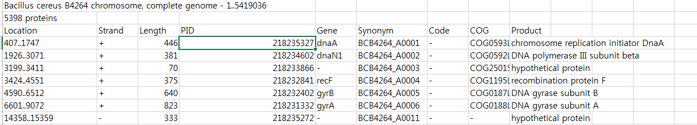
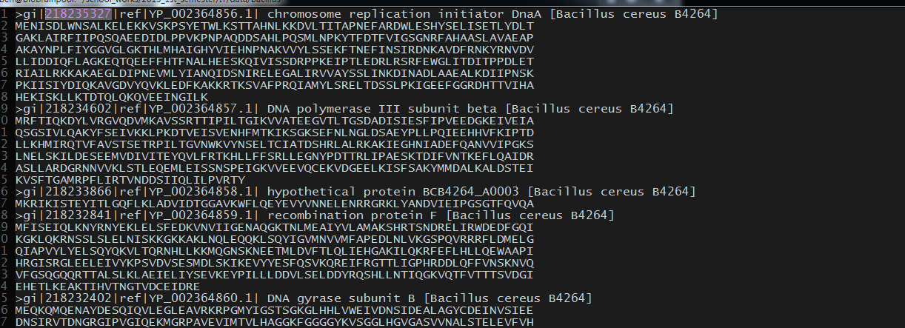
HW Tips
.ptt file
.faa file
PID
ADD These information
You will need to use Alter & Update

Slide 38
HW Submission ( Important notes )
Please submit a report(.doc or .pdf)
Report must include screenshots or copy&pasted tables of your process & results
No limitations in min&max of number pages.
2. Executable source code that have done the following process ;
create table
insert values into table
K-mer count
table modification
Note : single or multiple files are acceptable. (For multiple files, please compress it)
3. Results must be saved in the DB ( bioinfo_2015 ) with your own table.
Tables that are not named as “Student_ID”_”bacterianame” will be removed. Thus, will not be accepted.
4. As we are using limited number of accounts by multiple people, we heavily believe on your honesty.

Slide 39

Please send Source code& Report (or .zip) to Jotunnheim@snu.ac.kr
Greatly appreciated with a header [IT]
Recommended E-mail title : [IT]_학번_한글이름
Recommended file name : [IT]_학번_한글이름
For other cases, [IT]_STUDENTNUMBER_NAME
DEADLINE : April 8th , 3:59 PM

Slide 40
THANK YOU

